Slide 1
Name of the Group : GOT it
Product : Rock A Job
Team members :
1) Shubhkarman Sohi | sss669
2) Rohan Patel | rsp502
3) MD Saiduzzaman Talukder | mdt014
4) Alavi Sharar Khan | ask172

Slide 2
List of presenters
OUTLINE
1. Product Vision
2. Architecture
3. Personas/Roles
4. Epics
5. User Stories implemented
6. Quality Assurance Plan (testing, inspection, user acceptance)
7. Technologies Used
8. Screenshots and Short descriptions of the product
9. Next Steps
1. Saiduzzaman Talukder - Slides 1 - 6
2. Shubhkarman Sohi - Slides 7 - 12
3. Alavi Khan - Slides 13 - 17
4. Rohan Patel - Slides 18 - 23

Slide 3

Rock a Job
A job portal which helps our users to make quick money by doing jobs for users who are not skilled enough or capable enough to do the job on their own. jobs are not just limited to trimming lawns or shoveling snow but can vary vastly from designing and building a small webpage to walking a dog.

Slide 4
Product Vision
Rock A Job is a web-based application that provides people with the platform which gives them opportunities to both earn extra money and post jobs and get it done. It also supports features like check job-seekers profile before assigning a job to them, It gives job seekers options to filter and search among jobs posted by other users. Unlike other products were people can post jobs, but they are either fulltime or contract based or there are products like Kijiji or Craigslist which is not designed to be job search sites or has a complicated user-interface. A job post will have the job description along with the straight pay associated with it. The user posting the job will also have an option to make the post accept offers, which they can later browse to pick an offer.

Slide 5
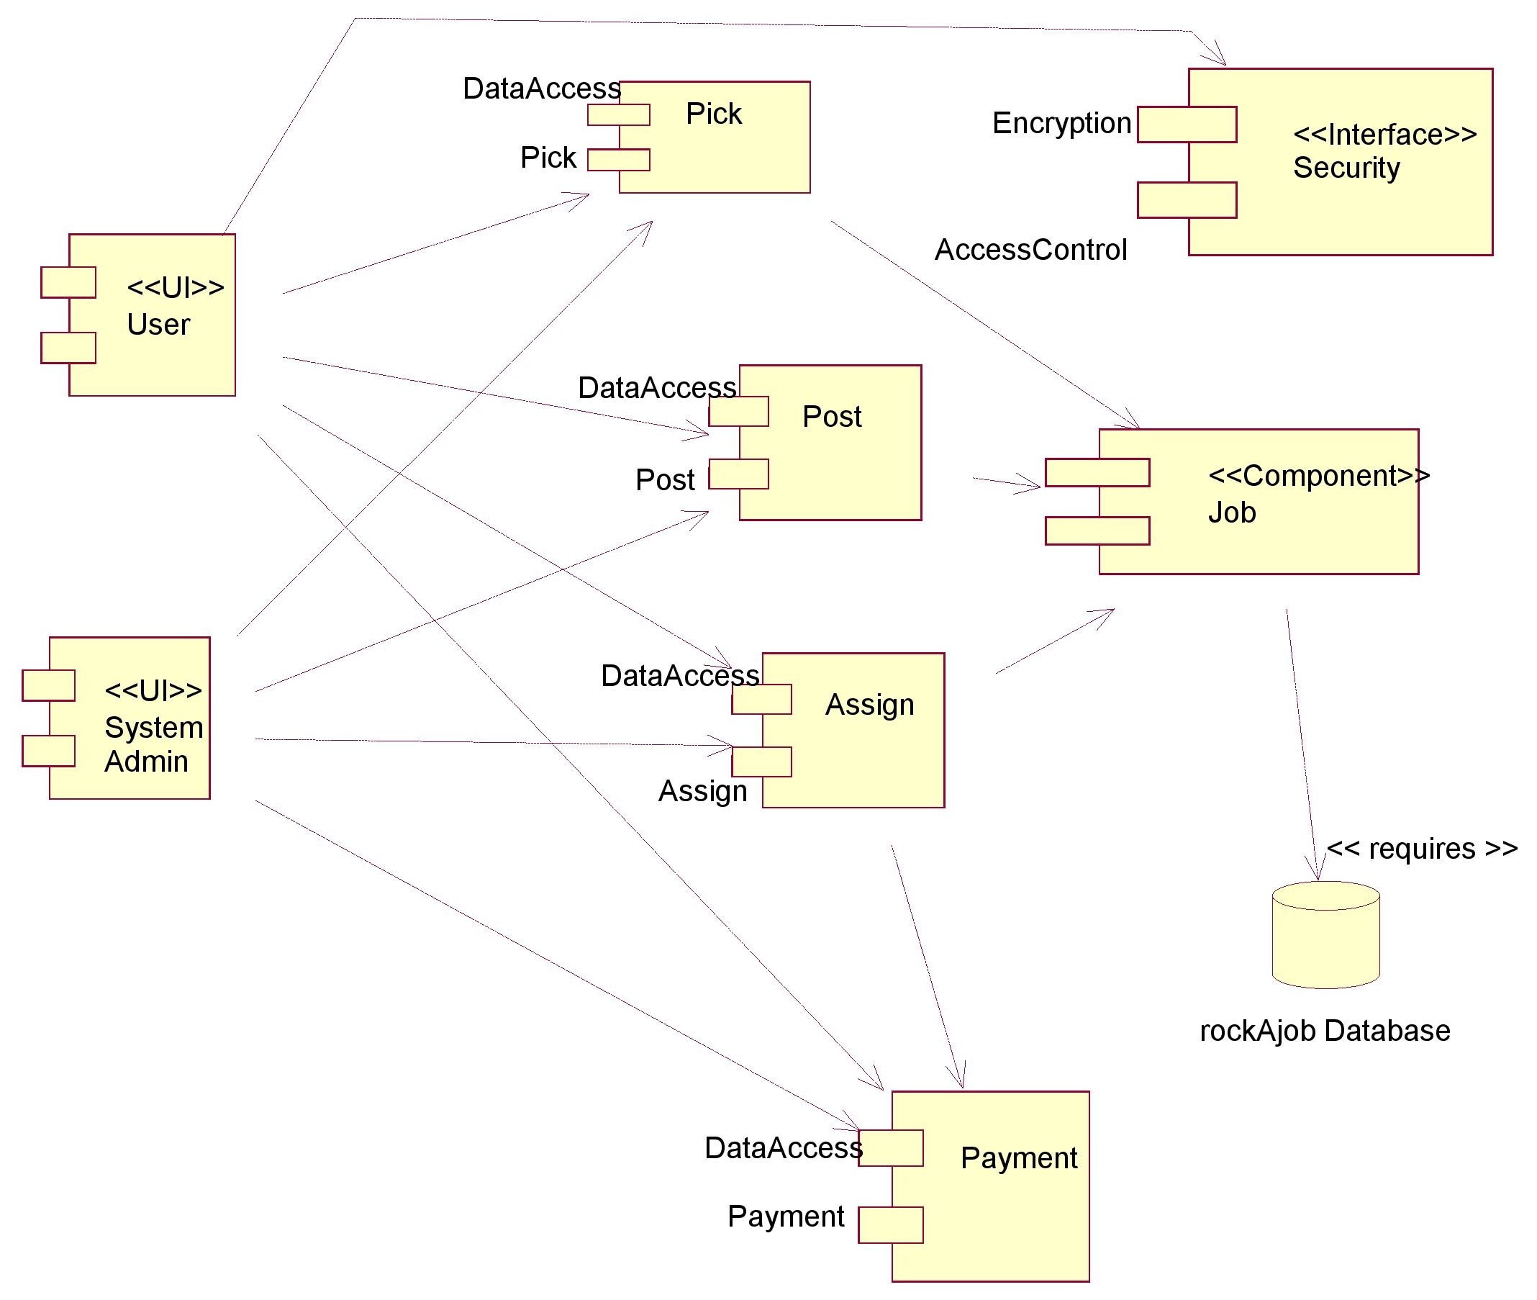
ARCHITECTURE DIAGRAM

Slide 6
Architecture DESCRIPTION
1) System admin has access over all the data
for all the classes
2) For security user password gets encrypted
before getting stored into the database to
maintain the system’s security
3) Job is the key component in the diagram. It is
the product of the software.
4) The user can post a job as well as pick a job
5) All the jobs are stored into the Rock A Job
database.
6) The User who posted the job can assign it to
one of the job seekers who applied for it.

Slide 7
Personas / Roles
Rachel Jackson is the HR and Scheduling manager of BuildItQuick a construction firm in the Bahamas.
She has a 9-5 job and likes it that way. She likes to follow a fixed schedule and gets frustrated when it gets interrupted by unwanted chores.
BuildItQuick's employees like to go on constant small-term vacations from work thus Rachel is always looking for small-term noncontract workers.
Harry Potter is an international student at UofS. He is very serious about his studies and does not want to compromise his studies for anything.
He wants to pay all of his living costs by himself. So he often looks for jobs. But as he does not want to be committed/contracted to a job for a long time for his busy study schedule, he looks for a job which is short term.
So that he can utilize his study break or holidays by working.

Slide 8
Personas / Roles – CONTINUED
Linda Williams is an old lady with many physical disabilities who has many houses in this small city.
She gives her houses for rent. She is living on her pensions and rents.
Every time she puts the houses for rent, she needs to do some renovation to the houses like painting, changing all the light bulbs, changing and cleaning the floor carpets, cutting the grasses of the backyard etc.
Linda Williams often needs for workers to make these kinds of works done. But she does not want to wait for a long time, and she prefers to have short term workers for her works.
Arjun Singh is a Permanent Resident in Canada (Originally from India).
He's the only one contributing to the family's income. He is currently doing a full-time job, but he finds it difficult to manage the family expenses.
He is always looking for some odd jobs which would be completed in a short duration and would pay him enough, To get the extra income in the house to carry out other unexpected expenses and trying to save money for any emergencies.

Slide 9
Personas / Roles – CONTINUED
James Wilson used to work as a web developer in a startup that recently declared bankruptcy which leads to him being laid off.
He is in great need of a job and with the hindering economy, it is close to impossible to do so.
He knows he has the skills but is just not able to implement them to good use. He has applied to dozens of companies but getting a new jobs always takes time.
He now has given up on the job search and is just doing some freelance work, which also has not caught much attention because he is not able to find a good platform to advertise himself.

Slide 10
EPICS
Harry Potter
Rachel Jackson
As a Manager, I would like to have a website from where I can find skilled construction workers to work with our firm for a small period. Mostly 1 or 2 days.
Being an international student, it would be amazing to have a website, where I can get to choose from lots of small term jobs according to my preference.
Linda Williams
Arjun Singh
As a senior resident, I would love to have a website where I can find skilled workers to work for a short time.
As the sole member contributing to the family's income. I would like to have an app or website which could help me find odd or flexible jobs and make some extra money to fulfill all the necessities of the family.

Slide 11
EPICS - CONTINUED
James Wilson
As an unemployed web developer who does not want to do a 9-5 job anymore, I am looking for a good platform to advertise my freelance work and earn some money until I figure my life out.

Slide 12
USER STORIES
Rachel Jackson
Harry Potter
1) As a manager I want to look at all the experienced construction workers in or around my area.
2) As a manager I want to post a job posting that wants to hire a short-time experienced construction worker
1) As a student, I would like to have a variety of job postings to choose from.
2) As a student, I would like to have an option to select a specific type of job to see if there is any job offers in my relevant field as that would be my specialty and first priority.

Slide 13
USER STORIES - CONTINUED
Linda Williams
Arjun Singh
1) As a senior citizen, I would like to have easy access to the professional or experienced worker for my non contracted jobs.
2) As a senior citizen, I would like to have a greater priority to my job posting as some of them needs to be done in a short time.
1) I would like to view jobs and complete them when I am free and not on my full-time job
2) I would like to make sure if the user posting the job is authentic and is giving me enough money to complete the job.

Slide 14
USER STORIES - CONTINUED
James Wilson
1) As an unemployed web developer I want to post my freelancer add on a platform where it will be visible to potential employes locally
2) As an unemployed web developer I want to see if somebody locally wants to get some small web design or implementation done.

Slide 15

Quality Assurance Plan
Functional Testing
Interface Testing
Database Testing
1. Testing to see if all the links are functional or not, which will include, Testing for the outgoing links from all the pages to the specific domain under test. 2. Testing for all internal links. 3. Links checking includes, check for broken links in all the above-mentioned links.
1. Testing the request are sent correctly to the Database and output at the client side is displayed correctly. Errors if any must be caught by the application and must be only shown to the administrator and not the end user. 2. Testing the web server is handling all application requests without any service denial. 3. Making sure all the queries are sent to the database give expected results.
1. Testing if there are any error shown while executing database queries. 2. Data integrity is being maintained while updating or deleting data in the database. 3. Testing if the data retrieved from our database is shown accurately in your web application.

Slide 16
Technologies Used
Languages
Additional tools
1) HTML
2) CSS
3) JavaScript
4) Jquery
5) MySQL
6) PHP
7) Bootstrap
8) JSON
1) WebStorm
3) Postman
4) PHP Storm
5) XAMPP
6) GitLab
7) Docker

Slide 17
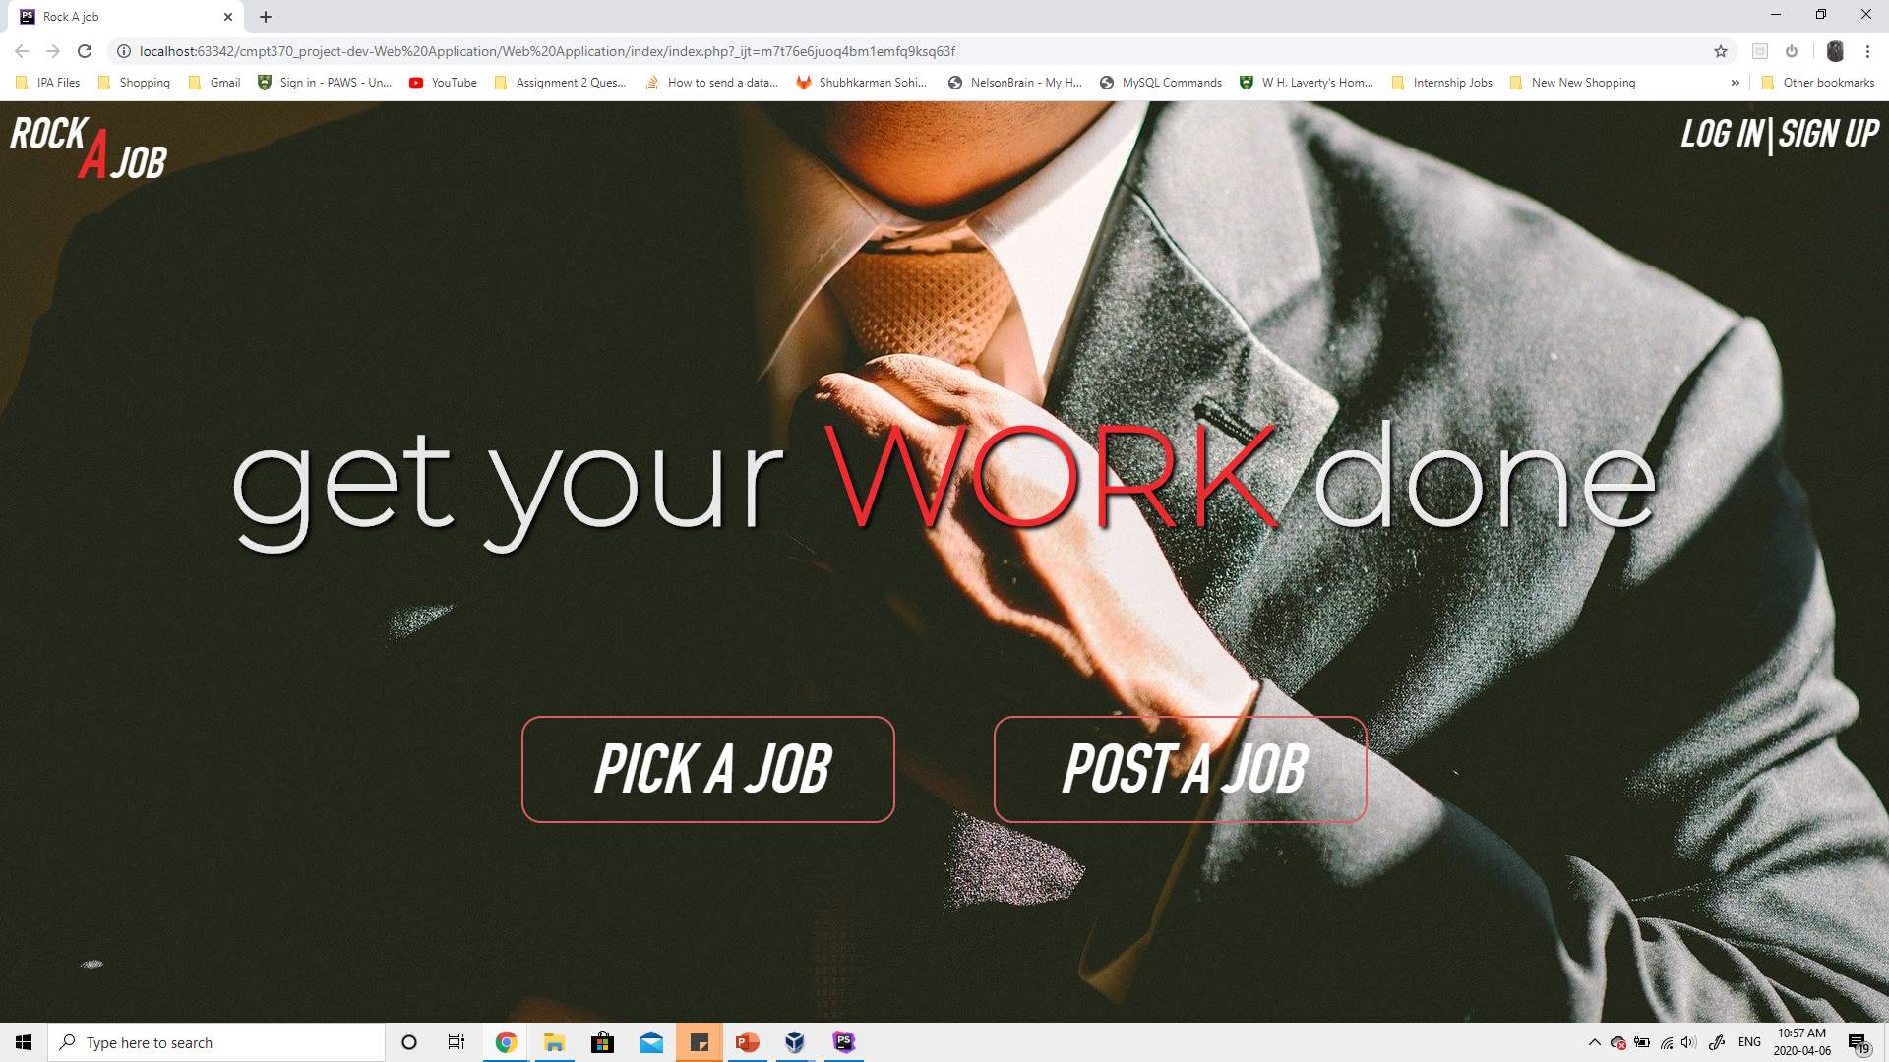
HOMEPAGE
Homepage of the Application you can navigate to any part of the website from this page.
Pick a Job option displays all the jobs in the database
Post a Job allows you to login and then post a job so that other people can see it
Login button redirects you to the login page where an existing user can login
Signup button redirects you to the signup page where a new user can register to use the Job-Portal
If you scroll down, you can see the about us section which tells you about our web-application.

Slide 18
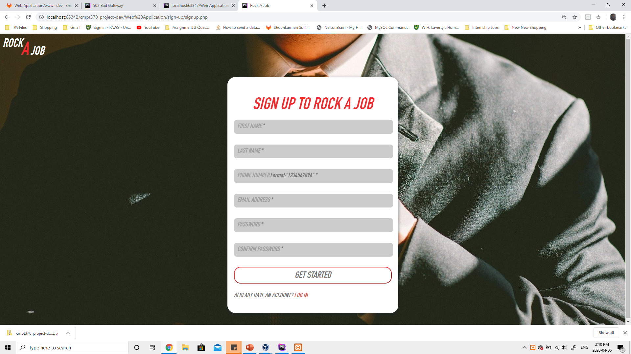
SIGNUP Page
Signup page allows a new user to register with our product
Which gives the users the functionality to either post a job or pick a job and search through a variety of jobs

Slide 19
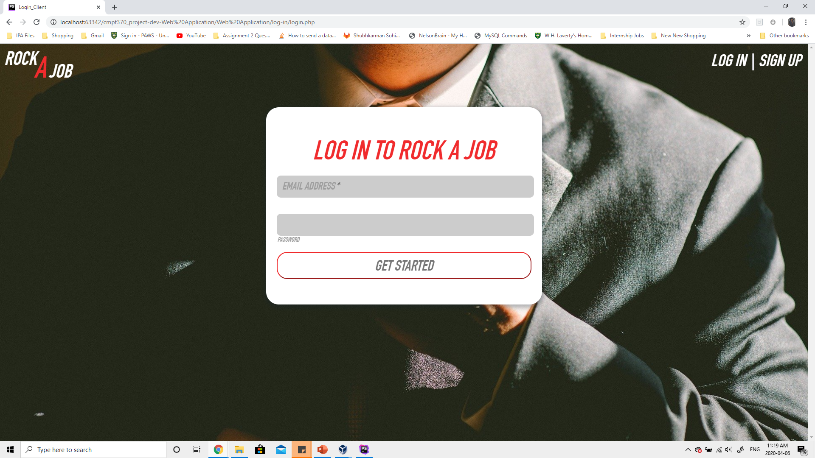
Login Page
Login page allows a existing user to login in to the website
Which gives the users the functionality to either post a job or pick a job and search through a variety of jobs

Slide 20
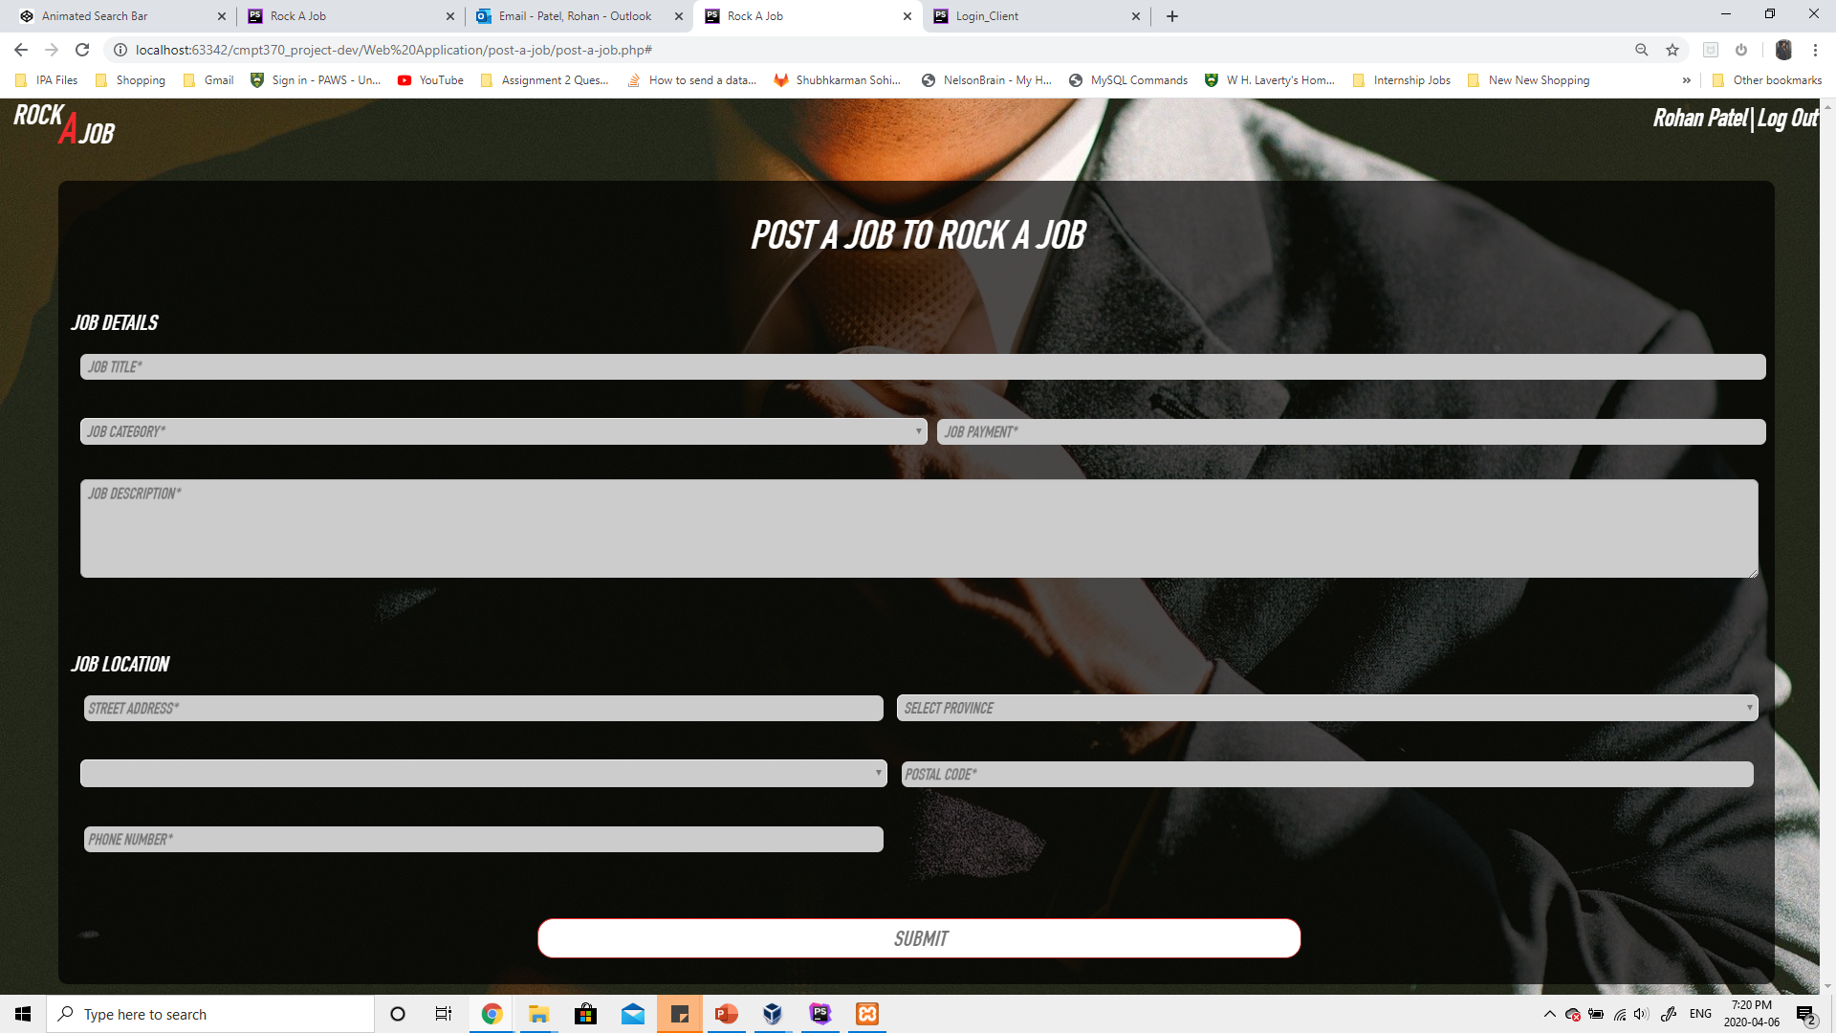
POST A JOB PAGE
Enter the details for the job that need to get done.
The form will add the job to a database and user’s seeking a job can view it and apply for the job.

Slide 21
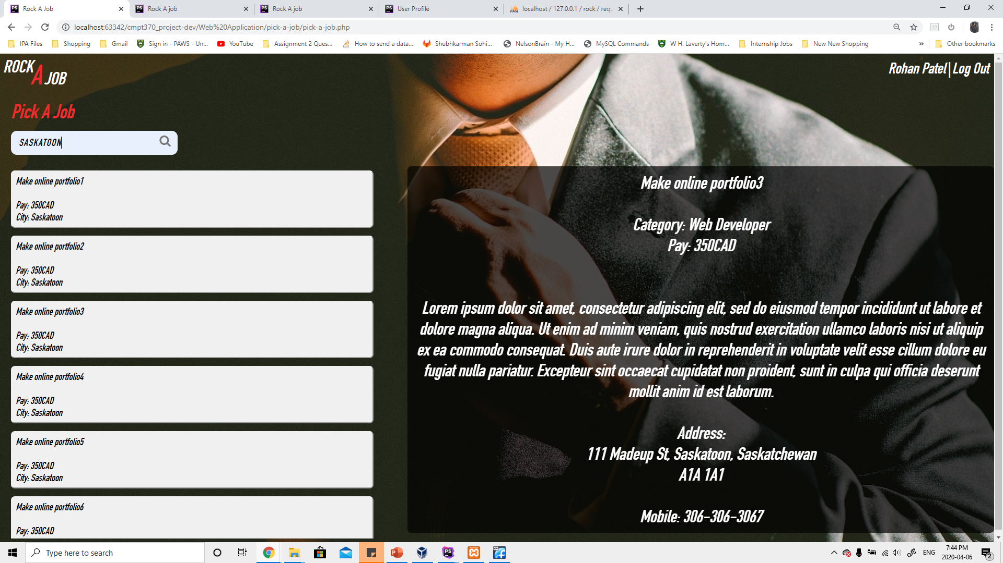
PICK A JOB PAGE
All the jobs in the database can be viewed on this page.
User’s seeking a job can also search for a particular kind of job using the search bar
The user seeking a job can apply for a job they like.

Slide 22
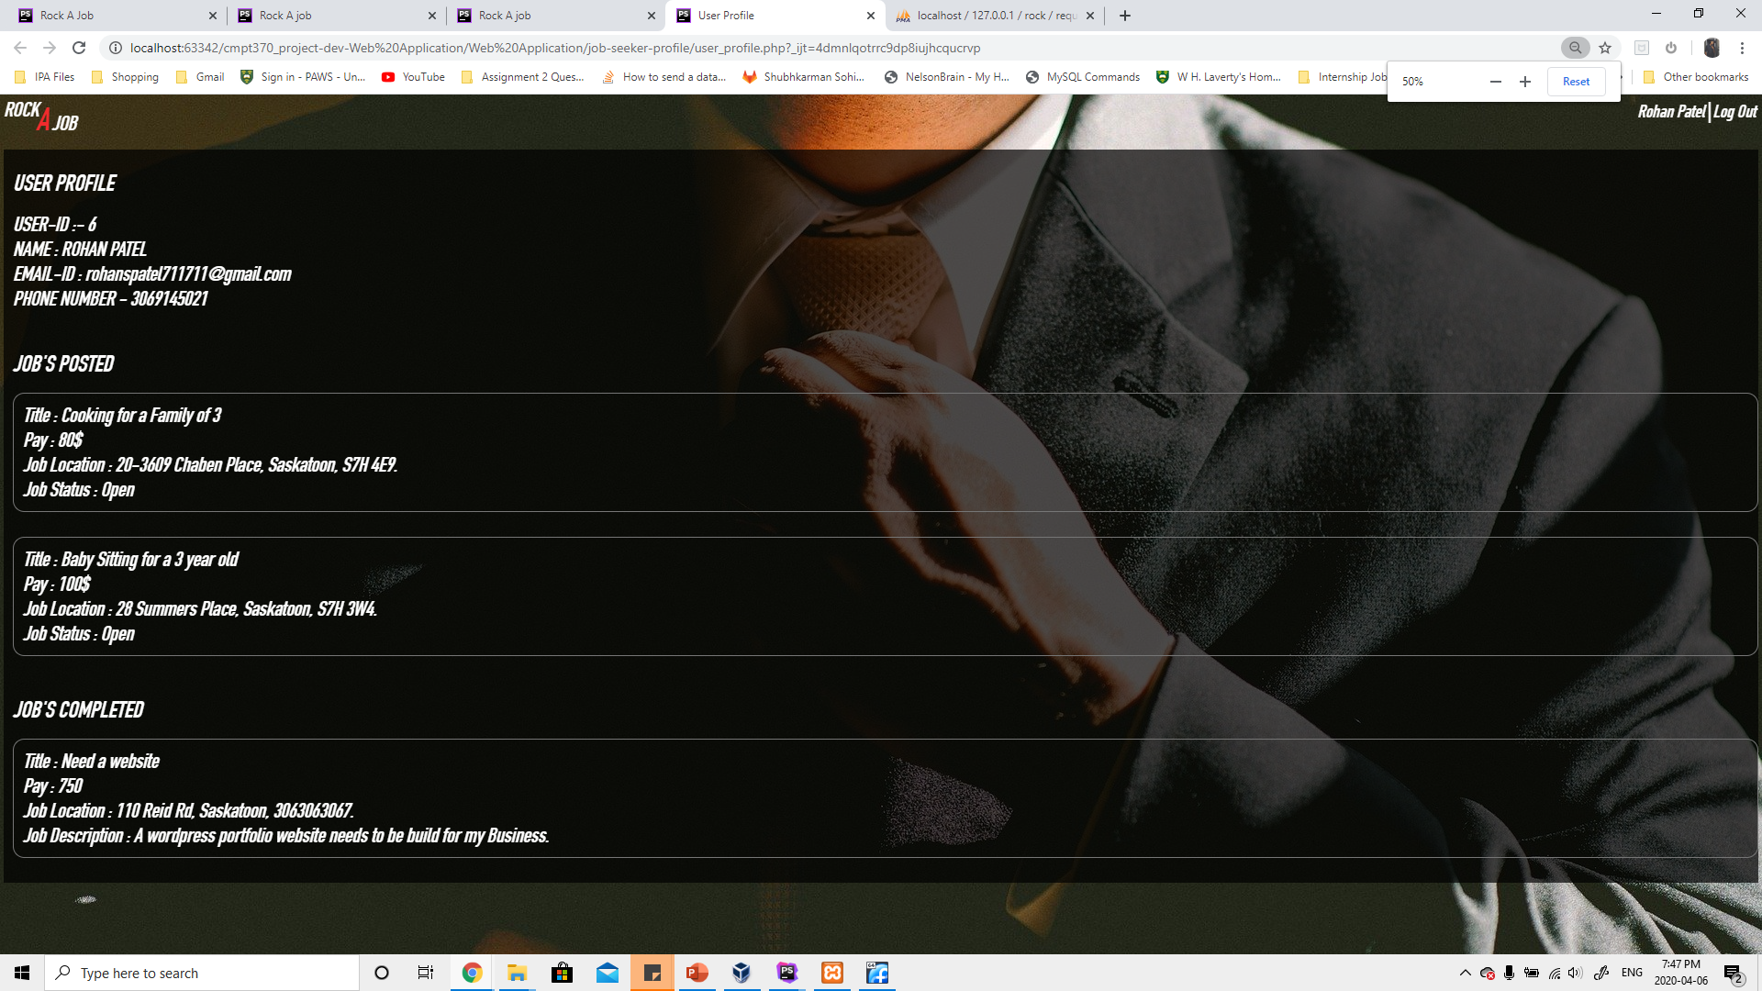
USER PROFILE PAGE
This page display all the user details including their email id, name, etc.
This page also displays job posted by a user and jobs completed by a user

Slide 23
Next Steps
Email Functionality
Other Functionalities
1. Whenever a user is assigned a job, he should receive a email containing the job details and the job posters contact information.
2. Sending a email when a new job is posted under the category of jobs that the user want to do or has the experience to do.
1. Ability to edit the job posted by a user.
2. Ability to edit the user details
3. Ability to give feedback for a user, be it a job seeker or a job poster.

